Slide 1

Jagdish lohni
Data Analyst

Slide 2
Slack Queries Analysis
The data represents Slack Queries of an Ed Tech Company and their resolution status.

Slide 3
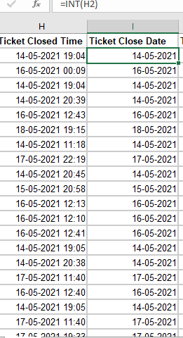
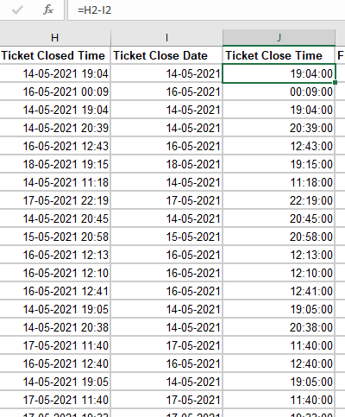
1.Check the Datatypes and convert relevant columns to Date and Time format.
=INT(H2)
=H2-I2

Slide 4
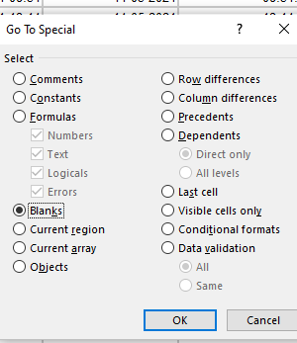
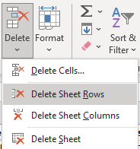
2.Fill Missing Values with Appropriate Method.
FIND THE BLANK CELL
DELETE SHEET ROWS

Slide 5
3. Check how many Students and Work Professionals are raising queries, who’s queries are more.

Slide 6
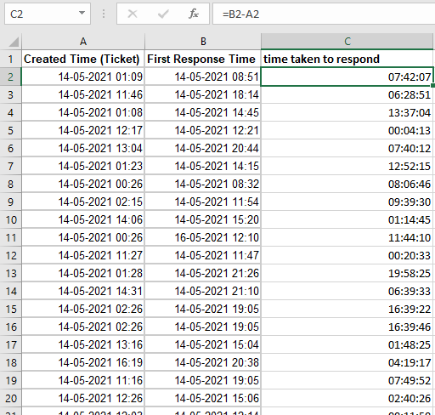
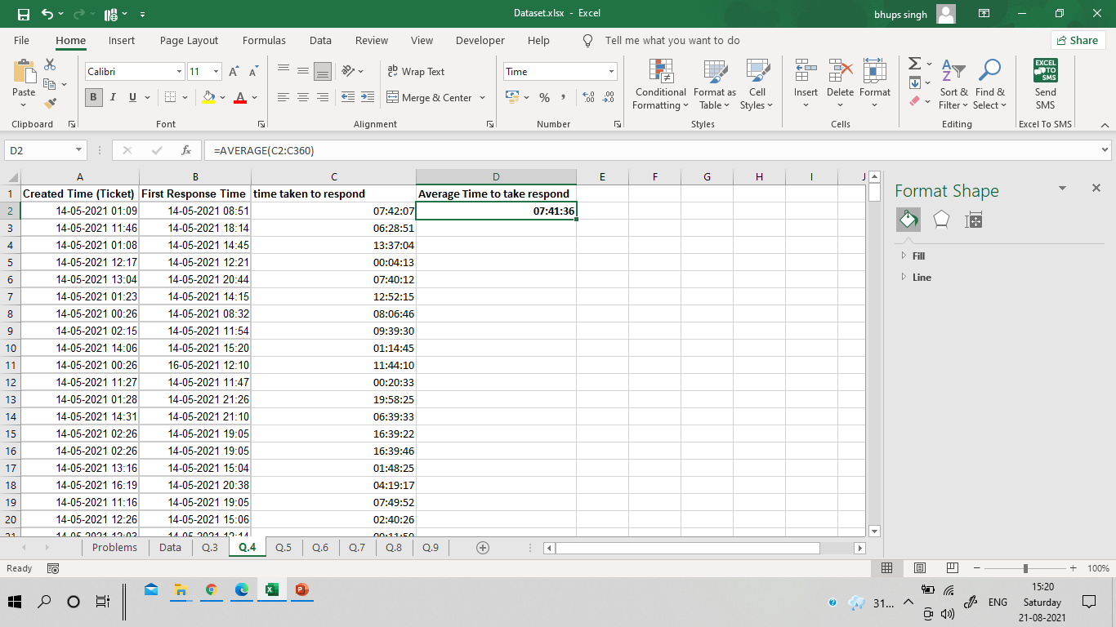
4.What is the Average time taken to respond to a query?
FIRST CREATE TIME TAKEN TO RESPOND
=(B2-A2)
AFTER THAT I AM USE
=AVERAGE(C2:C360)

Slide 7
5. List down top 10 queries that took longest time to resolve.

Slide 8
6. Which Phase of Project is having highest Queries?

Slide 9
7. Which project phase queries are taking a long time to resolve?

Slide 10
8. On which day highest queries were resolved?

Slide 11
Full Stack Phase -4 Take Minimum time To resolve so the Query of the Full Stack Phase is easier then other phase Queries
9. Which phase queries are easier to resolve?

